Slide 1
How Microservices and Serverless Computing Enable the Next Gen of Machine Intelligence
Jon Peck
Full-Spectrum Developer & Advocate
Making state-of-the-art algorithms
discoverable and accessible to everyone
jpeck@algorithmia.com
@peckjon
Algorithmia.com
Notes:
Seattle Building Intelligent Applications Meetup

Slide 2
The Problem: ML is in a huge growth phase, difficult/expensive for DevOps to keep up
Initially:
A few models, a couple frameworks, 1-2 languages
Dedicated hardware or VM Hosting
IT Team for DevOps
High time-to-deploy, manual discoverability
Few end-users, heterogenous APIs (if any)
Pretty soon...
> 5,000 algorithms (50k versions) on many runtimes / frameworks
> 60k algorithm developers: heterogenous, largely unpredictable
Each algorithm: 1 to 1,000 calls/second, a lot of variance
Need auto-deploy, discoverability, low (15ms) latency
Common API, composability, fine-grained security
Notes:
So the problem we faced was, how do we serve over 5000 different algorithms… which actually have multiple versions each so more like 50,000 individual services, where each algorithm might be getting called 1 to 1000 times a sec with massive fluctuation in demand and while providing a no devops experience to our users. Just as important is how we provide an overhead latency of under 15 ms across the system and on top of that allow users to create algorithms, functions and models using any runtime or framework.
Also worth mentioning that we want it to be deployable anywhere. Even though a majority of our infrastructure and customers are on AWS, being able to go to where the data is, and as a bonus avoiding lock-in, is critical for a AI platform.

Slide 3
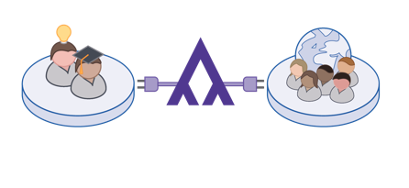
The Need: an “Operating System for AI”
AI/ML scalable infrastructure on demand + marketplace
Function-as-a-service for Machine & Deep Learning
Discoverable, live inventory of AI via APIs
Anyone can contribute & use
Composable, Monetizable
Every developer on earth can make their app intelligent
Notes:
Scalable infrastructure for Artificial Intelligence and machine learning on demand with the addition of also acting like a marketplace for discoverability and monetization.
- Provide a function as a service functionality for ML/AI
- A discoverable live inventory of AI
- A way to monetize and distribute these modules
- A way of composing them all together into systems or pipeline
All of this with the purpose of helping any developer on earth build intelligent AI driven applications.

Slide 4
An Operating System for AI
What did the evolution of OS look like?
General-purpose computing had a long evolution, as we learned what the common problems were / what abstractions to build. AI is in the earlier stages of that evolution.
An Operating System:
Provides common functionality needed by many programs
Standardizes conventions to make systems easier to work with
Presents a higher level abstraction of the underlying hardware
Unix
Multi-tenancy, Composability
GUI (Win/Mac)
Accessibility
Punch Cards
1970s
DOS
Hardware Abstraction
iOS/Android
Built-in App Store
(Discoverability)
Notes:
What we’re talking about here is not a literal operating system. We’re not talking about a competitor to linux or windows. What I mean is looking at how operating systems have evolved over time in terms of functionality and design to make computing more accessible, and then attempting to draw an analogy with the development of AI.
The history of Operating systems has been marked by an increase of abstraction over time.
- We started with punch cards – raw assembly code
- Then came unix allowing for multitenancy and composability (piping) – an increase of abstraction
- Then came DOS which allowed for running the same OS on different hardware – we got hardware abstraction
- Then came the GUI which provided accessibility – yet another level of abstraction
- Finally came iOS/Android which added discoverability, and the ability to expand functionality (and monetize) through app stores.
We’ve learned a lot about building large scale AI systems. Based on our experiences, Here is an approach we took and what we think a blueprint for an OS for AI might look like.
What we’re looking for here is the right set of high-level abstractions needed, so that AI can be accessed in a standardized way, regardless of the languages, frameworks, or hardware in play.

Slide 5
Use Case
Jian Yang made an app to recognize food “SeeFood”
© HBO All Rights Reserved
Notes:
Let’s take the hypothetical example of our friend Jian Yang who is building his app “SeeFood”. This is an AI driven application that when it takes a picture of a food can recognize what that food is. He uses his favorite deep learning framework to build the classification model, probably locally on his laptop, or on a rented GPU instance from his favorite cloud provider.
With a use case in mind, let’s see how this might be developed.

Slide 6
Use Case
He deployed his trained model to a GPU-enabled server
?
GPU-enabled Server
Notes:
Initially this is fairly straightforward. Once he has built his App that will take the image and pass it to the model, Jian Yang can deploy his trained model to a GPU enabled server.

Slide 7
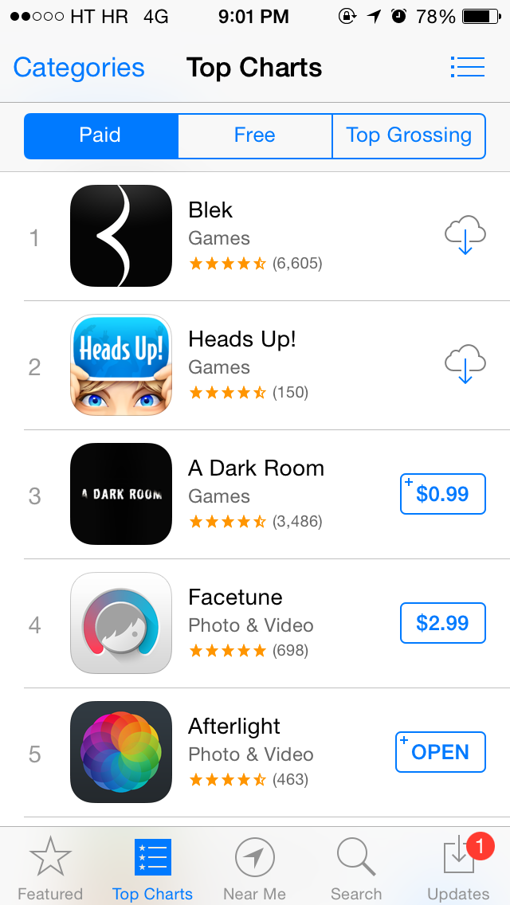
Use Case
The app is a hit!
SeeFood
Productivity
Notes:
Suddenly over night, the app virally becomes extremely popular. Thousands of users download it and start sending food classification images to the server.

Slide 8
Use Case
… and now his server is overloaded.
?
?
?
xN
GPU-enabled Server
Notes:
Now with thousands of images coming at the same time, the server is overloaded. Remembering that his classification model can only classify one image at the time (even if the classification only takes a couple of seconds or less). Here lies the problem, when scaling rapidly AI models and something developers building intelligent applications will hit ever more often as these applications become more mainstream.
There are dozens of tutorials out there for getting started with tensorflow, keras, pytorch, etc, but what is less commonly talked about is how you productionize those models, and scale them to 1000s of users.
some of the challenges of scaling GPUs specifically:
Drivers
Docker
Memory

Slide 9
Characteristics of AI
Two distinct phases: training and inference
Lots of processing power
Heterogenous hardware (CPU, GPU, FPGA, TPU, etc.)
Limited by compute rather than bandwidth
“Tensorflow is open source, scaling it is not.”
Notes:
To begin that journey, let’s briefly review some of the characteristics of AI:
a) It usually consists of two very distinct phases: training and inference. Training is when we actually build the model or make the machine learn. Inference is once the model is learned allowing it to make predictions or classifications.
b) Regardless of training or inference, AI workloads tend to take a LOT of computing power. Neural nets are especially computationally intense.
c) Today AI gets done on an array of heterogeneous hardware from CPUs, to GPUs to specialized hardware like TPUs or other Application Specific Integrated Circuits (ASICs).
d) AI tasks tend to be limited more by compute than bandwidth
e) Finally, although there is an ever growing set of open-source toolkits for building AI models, scaling is a much complicated and expensive task -- from both a compute perspective and an operational perspective.

Slide 10
TRAINING
OWNER: Data Scientists
Long compute cycle
Fixed load (Inelastic)
Stateful
Single user
Notes:
So as I mentioned there is usually 2 phases to AI and the first is training. Training is building a model, it’s a task usually done by a data scientist or machine learning engineer. For example if you want to train an image classifier to tell you if any image is a hot dog or not a hot dog.
Some characteristics of training are that:
- Training tends to a be a long running task, models might take a few hours to potentially days to train depending on the size of the data set.
- Its also a fixed load task or inelastic. There are no sudden increases or decreases in load or demand. Even if we can’t exactly predict the load to train a given model, it is usually not critically time sensitive, and can be allowed to run for as long as necessary on the available hardware.
- Statefulness is important, as we train we care to save checkpoints and weights.
- Finally we tend to feed data in from a single source and its done by a single user. Maybe HDFS, an S3 bucket or blob storage.

Slide 11
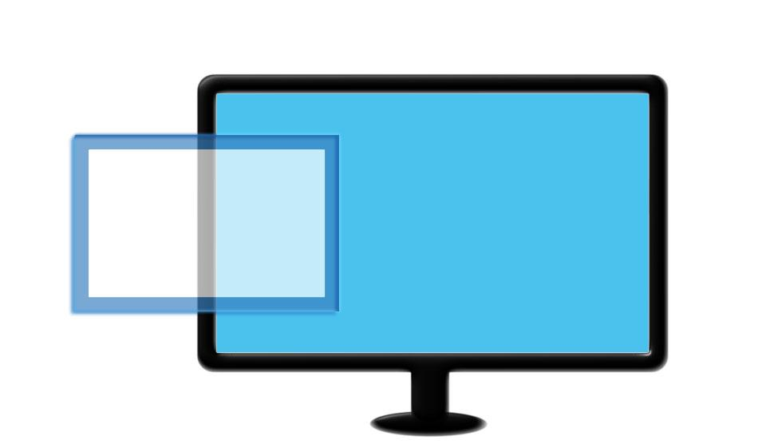
TRAINING
OWNER: Data Scientists
Long compute cycle
Fixed load (Inelastic)
Stateful
Single user
Analogous to dev tool chain.
Building and iterating over a model is similar to building an app.
Metal or VM
Notes:
The training phase of building AI models is analogous to building an app. It’s usually quite framework specific, there is a specific dev tool chain that can be used based on your choice and it’s an iterative process. Today we are seeing numerous tools that help build these “apps” or ai models like Keras, Tensorflow, CNTK amongst many others.
But, today we are really going to concentrate more on talking about the inference side of things, because it’s rarely talked about and it’s crucial to the success of making AI driven applications main stream both for individual developers as well as large enterprises.

Slide 12
TRAINING
INFERENCE
OWNER: Data Scientists
OWNER: DevOps
Long compute cycle
Short compute bursts
Fixed load (Inelastic)
Stateless
Stateful
Elastic
Single user
Multiple users
Analogous to dev tool chain.
Building and iterating over a model is similar to building an app.
Metal or VM
Notes:
So we talked about the characteristics of training. Lets now talk about inference.
Whereas training is typically owned by the data scientist or machine learning engineer – inference is a task that makes more sense to be owned by devops, the people responsible for the pipes and infrastructure. In the case of our SeeFood app, it’s the phase where we take the model and make it available as a service to thousands of mobile phones and websites.
The characteristics of this phase include:
- Short burst of intense compute: classifying an image might take 100ms to a couple of seconds
- It’s stateless, we are classifying an image not training it. The result of one user’s classification does not affect the other.
- It’s elastic. Many people might use the application at a certain time. Going from 1 image per second to potentially 100s requires an increase in available resources, this means more machines and more gpus.
- It will be used by multiple users on multiple platforms.

Slide 13
TRAINING
INFERENCE
OWNER: Data Scientists
OWNER: DevOps
Long compute cycle
Short compute bursts
Fixed load (Inelastic)
Stateless
Stateful
Elastic
Single user
Multiple users
Analogous to dev tool chain.
Building and iterating over a model is similar to building an app.
Analogous to an OS.
Running concurrent models requires task scheduling.
Metal or VM
Notes:
Those two verticals are similar to building an app versus run apps, in traditional operating systems.
Building an app (or model) is very framework dependent. Every use case is unique, and there are many efforts out there that try to make it a better experience, such as Keras for example. Also important to note is that training generally a one-time activity, so the approach is quite different.
However running heterogenous models, simultaneously, is analogous to how an operating system works. It’s about sharing of resources between models, prioritizing them, monitoring them, etc. It’s the world where you “Shipped” the app, and it’s running for many of your users concurrently.
This is the part the should be common across all kinds of AI and Machine learning services, and should not be the “creative” part of doing data science. It requires years of study to be a good data scientist or machine learning engineer, and it is a drastically different skill set than scaling compute elastically to 100s of nodes.
We will focus on the right side - the Inference. Overall large scale inference is analogous to an OS where amongst other requirements task scheduling is crucial.

Slide 14
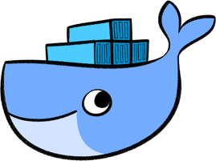
TRAINING
INFERENCE
OWNER: Data Scientists
OWNER: DevOps
Long compute cycle
Short compute bursts
Fixed load (Inelastic)
Stateless
Stateful
Elastic
Single user
Multiple users
Analogous to dev tool chain.
Building and iterating over a model is similar to building an app.
Analogous to an OS.
Running concurrent models requires task scheduling.
Metal or VM
Containers
Notes:
Okay so what technologies should we choose for these tasks?
Because of the long compute cycle, fixed load, statefulness, training is usually run by a single user often in VMs or baremetal or even a data scientist’s own laptop. They are good options for these characteristics. I won’t touch on the topic of distributed training here, except to say that it is very early days, the tooling is not quite there yet, and has its own sets of challenges that deserve their own talk.
For inference containers are a much better fit given how quickly they can be initialized, there much lighter weight and the ability to very quickly replicate and run them in parallel. By default containers are also stateless.

Slide 15
TRAINING
INFERENCE
OWNER: Data Scientists
OWNER: DevOps
Long compute cycle
Short compute bursts
Fixed load (Inelastic)
Stateless
Stateful
Elastic
Single user
Multiple users
Analogous to dev tool chain.
Building and iterating over a model is similar to building an app.
Analogous to an OS.
Running concurrent models requires task scheduling.
Metal or VM
Containers
Kubernetes
Notes:
So containers give us fast and stateless two things we require for our operating system. The third big one is being elastic since demand will change over time. Kubernetes is designed for running, provisioning, and scaling services, and is in many ways perfect for this task.
There are other container orchestration tools out there that work well. What was important to us was being able to move off of cloud-specific tools for scaling and onto an open source tool that could be deployed on any cloud.

Slide 16
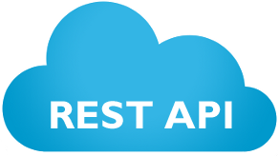
TRAINING
INFERENCE
OWNER: Data Scientists
OWNER: DevOps
Long compute cycle
Short compute bursts
Fixed load (Inelastic)
Stateless
Stateful
Elastic
Single user
Multiple users
Analogous to dev tool chain.
Building and iterating over a model is similar to building an app.
Analogous to an OS.
Running concurrent models requires task scheduling.
Metal or VM
Containers
Kubernetes
Notes:
So we get fast and stateless from containers, elastic scale from kubernetes the last component we need is accessibility from multiple users and usually multiple clients and devices. REST APIs are the final component allowing us to connect to any model from a mobile app, web application or IoT device. Rest APIs are universal.
So combining docker, kubernetes and rest apis and you have essentially built out your own microservices architecture.

Slide 17
Microservices & Serverless Computing => ML Hosting
MICROSERVICES: the design of a system as independently deployable, loosely coupled services.
SERVERLESS: the encapsulation, starting, and stopping of singular functions per request, with a just-in-time-compute model.
ADVANTAGES
Maintainable, Scalable
Software & Hardware Agnostic
Rolling deployments
ADVANTAGES
Elasticity, Cost Efficiency
Concurrency
Improved Latency
+
+
Notes:
We talked about the first and most obvious problem of scaling AI systems. 2 paradigms that I will be discussing today is microservices and serverless. Both in our opinion extremely important parts of an OS for AI.
Microservices is the design of a system that is componentized, independently deployable and loosely coupled. This is basically taking the idea of service-oriented-architecture to its logical conclusion. You’re not going to run heavy AI work loads on your web servers, because they will crawl. You want to have distinct services. Microservices are easier to maintain and scale, are software agnostic (runtimes in multiple languages, AI frameworks etc) amd hardware agnostic (our platform can run on any cloud or almost any other hardware), and allow for independently versioned services (for rolling deployments).
Serverless is a paradigm where developers thing in terms of services nor servers. A serverless architecture generally provides encapsulation, starting and stopping of single functions per request with a just in time compute model (only use and pay for what you need) Its advantages include elasticity, cost efficiency, massive concurrency (horizontal scaling), and improved latency
All of these are crucial components for an operating system for AI and you will see why.

Slide 18
Why Serverless - Cost Efficiency
Jian Yang’s “SeeFood” is most active during lunchtime.
160
40
Max calls/s
140
35
120
30
100
25
Calls per Second
GPU Server Instances
80
20
60
15
40
10
Avg calls/s
20
5
12 AM | 02 AM | 04 AM | 06 AM | 08 AM | 10 AM | 12 PM | 02 PM | 04 PM | 06 PM | 08 PM | 10 PM
Notes:
First let’s explore Cost/Efficiency by going back to the example of Jian Yang. This is what daily app usage to his classification model might look like, we notice that at lunch time a lot more people are sending images. We can see the peak amount of calls per second, the average amount of calls across the period. And here we can see the number of GPU server instances it would require to support this hypothetical load for this app.

Slide 19
Traditional Architecture - Design for Maximum
40 machines 24 hours. $648 * 40 = $25,920 per month
160
40
Max calls/s
140
35
120
30
100
25
Calls per Second
GPU Server Instances
80
20
60
15
40
10
Avg calls/s
20
5
12 AM | 02 AM | 04 AM | 06 AM | 08 AM | 10 AM | 12 PM | 02 PM | 04 PM | 06 PM | 08 PM | 10 PM
Notes:
If we went with an traditional, on-premise compute cluster, you would have to design for the maximum. This even has a name, called “capacity planning”.
With this architecture we are spending the max amount of servers required 24/7.

Slide 20
Autoscale Architecture - Design for Local Maximum
19 machines 24 hours. $648 * 40 = $12,312 per month
160
40
Max calls/s
140
35
120
30
100
25
Calls per Second
GPU Server Instances
80
20
60
15
40
10
Avg calls/s
20
5
12 AM | 02 AM | 04 AM | 06 AM | 08 AM | 10 AM | 12 PM | 02 PM | 04 PM | 06 PM | 08 PM | 10 PM
Notes:
In a traditional microservices architecture we would design for a local maximum, scaling up and down the machines based on step functions. Huge cost improvements over a traditional architecture.

Slide 21
Serverless Architecture - Design for Minimum
Avg. of 21 calls / sec, or equivalent of 6 machines. $648 * 6 = $3,888 per month
160
40
Max calls/s
140
35
120
30
100
25
Calls per Second
GPU Server Instances
80
20
60
15
40
10
Avg calls/s
20
5
12 AM | 02 AM | 04 AM | 06 AM | 08 AM | 10 AM | 12 PM | 02 PM | 04 PM | 06 PM | 08 PM | 10 PM
Notes:
Finally if we take the serverless approach we are actually designing for minimum. As requests come in we can quickly spin up models to serve them making sure we ONLY pay for the calls being made. In our example off the bat we see a 85% cost reduction!
Just automatically scaling up and down the demand is highly efficient and a serverless architecture is perfect for this.
Side note: there does need to be a little overhead to be ready for unexpected traffic. As serverless architectures become more popular and sophisticated, they can benefit from better predictive planning, and from increased liquidity of having more users and services.

Slide 22
Why Serverless - Concurrency
Load Balancer
?
?
?
GPU-enabled Servers
Notes:
Second aspect is concurrency. We are potentially going to have 1000s of users at the same time sending 100s of images per second. Since we know each model can only process images serially then horizontally scaling so as to support the usage is crucial. A serverless architecture allows for quick and easy replication of the model. When adding a load balancer in front we get the concurrency we need (and its all stateless!)

Slide 23
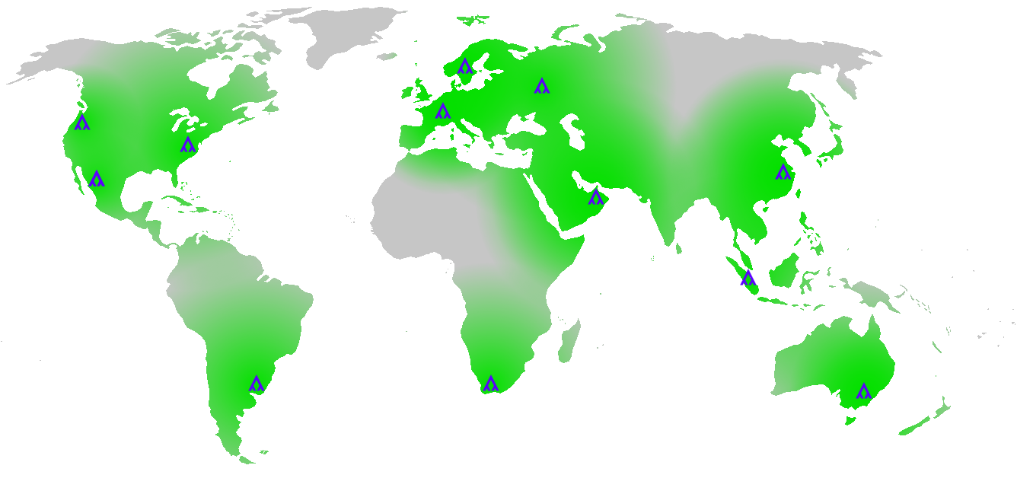
Why Serverless - Improved Latency
Portability = Low Latency
Notes:
Finally, improved latency is crucial. Remember data is heavy and expensive to move around but compute is light and cheap. Replicating your AI models across the globe, across clouds and across centers ensures that no matter what device or from what geo location you are hitting your model you will have a low latency and good experience for your users.

Slide 24
+
+
Almost there! We also need:
GPU Memory Management, Job Scheduling, Cloud Abstraction,
Discoverability, Authentication, Logging, etc.
Notes:
So following basic principles of microservices and serverless architecture plus using modern cloud native tool sets is great and will get you started on the right path – but there are other necessary critical parts for make this a cohesive platform, specifically when dealing with machine learning and deep learning workflows.
These things like GPU memory management where we allows users to call a deep learning algorithm, load it into GPU memory, compute and return the result immediately.
Prioritizing or intelligent orchestrations of the containers (ie knowing that one algorithm or model calls another, making sure they are stacked on the same resources or close to each other to reduce latency and cost.

Slide 25
Elastic Scale
Web Load Balancer
Web Servers
User
API Load Balancer
API Servers
Cloud Region #1
Cloud Region #2
Worker xN
Worker xN
Docker(algorithm#1)
..
Docker(algorithm#n)
Docker(algorithm#1)
..
Docker(algorithm#n)
Notes:
This is a high-level view of a simple, elastic, serverless architecture.
Steps:
An API call comes in from the user, hits the API load balancer, and reaches the API Server.
The API server assigns this request to a worker using a scheduler.
The worker pool consists of server instances, where each server can run multiple services.
Speed is obviously very important. In our case we’ve achieved around 15ms from ELB to algorithm entry point on standard AWS hardware. Your milage may vary depending on hardware and cluster load.
If you build this? Congrats you just made AWS Lambda.
But what else do you need for AI work loads?

Slide 26
Elastic Scaling with Intelligent Orchestration
Runtime Abstraction
FoodClassifier
Knowing that:
Algorithm A always calls Algorithm B
Algorithm A consumes X CPU, X Memory, etc
Algorithm B consumes X CPU, X Memory, etc
Therefore we can slot them in a way that:
Reduce network latency
Increase cluster utilization
Build dependency graphs
FruitClassifier
VeggieClassifier
Notes:
An OS will want to capture information around resource utilization for each component but also understand chains and compositions to be able to intelligently allocate resources.
So in our example here, the OS not only know what each component uses of CPU, memory and IO, etc but also that Algorithm A always calls Algorithm B or C and the resources for Algorithms B and C.
Therefore our OS can now slot and orchestrate work to reduce network latency, increase cluster utilization and build dependency graphs.
Lets call this Intelligent Elastic Scaling and this covers the first part of the Kernel. The second part of the Kernel is Runtime Abstraction.
Your algorithm might be written in Python. However when everything is running in a Docker container and via universal API, then we can compose across services. So the other algorithms can be written in anything from Java to R with Tensorflow and anything else.
We can support Python, Java, Scala, Rust, NodeJS, Ruby, and R... it’s just a Docker image!
If you need a “sentiment analysis” algorithm, then what do we do? We search google for “sentiment analysis python”.
This problem should not be runtime-based. You should be able to use any sentiment analysis model from any language.

Slide 27
Composability
Composability is critical for AI workflows because of data processing pipelines and ensembles.
Fruit or Veggie
Classifier
Fruit
Classifier
Veggie
Classifier
cat file.csv | grep foo | wc -l
Notes:
Composability is crucial to AI workflows because of data processing pipeline and ensembles. Truth is in our example our food recognizer would probably not be one model but a collection or ensemble of models for increased accuracy. Something like a classifier that was very accurate in detecting if something was a fruit or veggie and then depending on what that first step gave a second classification on accurately identifying the fruit or the veggie.

Slide 28
Cloud Abstraction - Storage
# No storage abstraction
s3 = boto3.client("s3")
obj = s3.get_object(Bucket="bucket-name", Key="records.csv")
data = obj["Body"].read()
# With storage abstraction
data = client.file("blob://records.csv").get()
s3://foo/bar
blob://foo/bar
hdfs://foo/bar
dropbox://foo/bar
etc.
Notes:
The last part of the Kernel is about the DevOps - and the key takeaway here is that we no longer expect programmers to do devops. This is especially true for machine learning engineers.
The reason an operating system exists is you do not want to take care of different hardware. Kubernetes is immensely valuable in creating that strong abstraction layer that helps the devops better manage their services. What we try to do here in our OS is to give our users a complete no-devops environment.

Slide 29
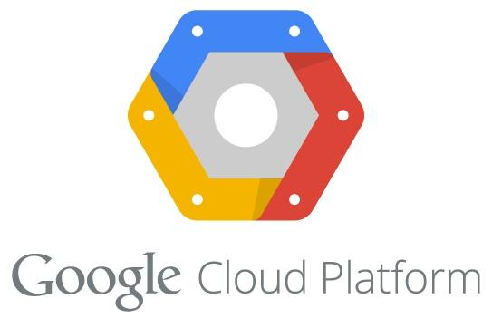
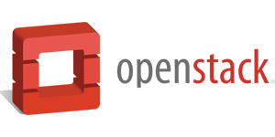
Cloud Abstraction
Compute | EC2 | CE | VM | Nova
Autoscaling | Autoscaling Group | Autoscaler | Scale Set | Heat Scaling Policy
Load Balancing | Elastic Load Balancer | Load Balancer | Load Balancer | LBaaS
Remote Storage | Elastic Block Store | Persistent Disk | File Storage | Block Storage
Partial Source: Sam Ghods, KubeConf 2016
Notes:
A great example of Environment abstraction
When you build a model, and especially in our quest to encourage composability, you will want to allow the consumer of the model to specify where the data is instead of it being hard coded to one data source.
The example I’ve been showing so far is the piece of code on the right where it is loading a CSV file from a generic blob storage.
Above is the alternative way of doing it, the usual way, which requires a hard coded S3 connector.
The problem with the piece of code on the left is that if you want to pass in something like HDFS, or you moved to Azure, then you need to re-write that portion of you model, for every model.
So in our Operating System, we will create a “data adapter” that will translate file paths to file blobs that a model can immediately use.

Slide 30
An Operating System for AI: the “AI Layer”
Shell & Services
Discoverability, Authentication, Instrumentation, etc.
Kernel
Elastic Scale
Runtime Abstraction
Cloud Abstraction
Prioritize and automatically optimize execution of concurrent short-lived jobs.
Support any programming language or framework, including interoperability between mixed stacks.
Provide portability to algorithms, including public clouds or private clouds.
Notes:
This is how we think an Operating System for AI will look like.
(1) The first layer is the shell and services. This is the part that you as a user interact with (the shell, or website) in addition to non-core services and applications, such as auth and monitoring.
(2) The second layer is the kernel. This is really what defines an OS in a technical level. It is what enables time-sharing, multi-tasking, etc.
The AI Layer as the same two parts: the frontend, where users can discover algorithms submitted by other users, manage data, setup API keys, etc. All of those are considered “Shell and Services”.
The core of the AI Layer is in the “Kernel”, and that’s what I’m going to focus on in the coming slides. The light purple boxes.
The Kernel is basically everything under-the-hood, that includes not only about launching a new server instance when we need to, but also about how do we minimize latency and maximizes cluster utilization when Algorithm A calls Algorithm B. It also makes decisions on what algorithms to keep in memory and what to unload, all in a fraction of a second. And allows users to run on hybrid clouds or deploy into new clouds or zones when they need to.
In the coming slides I want to take each vertical and break it down further. Starting with the far left, Elastic Scaling.

Slide 31
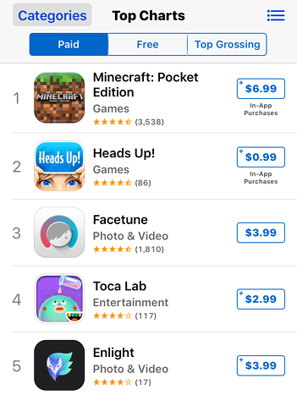
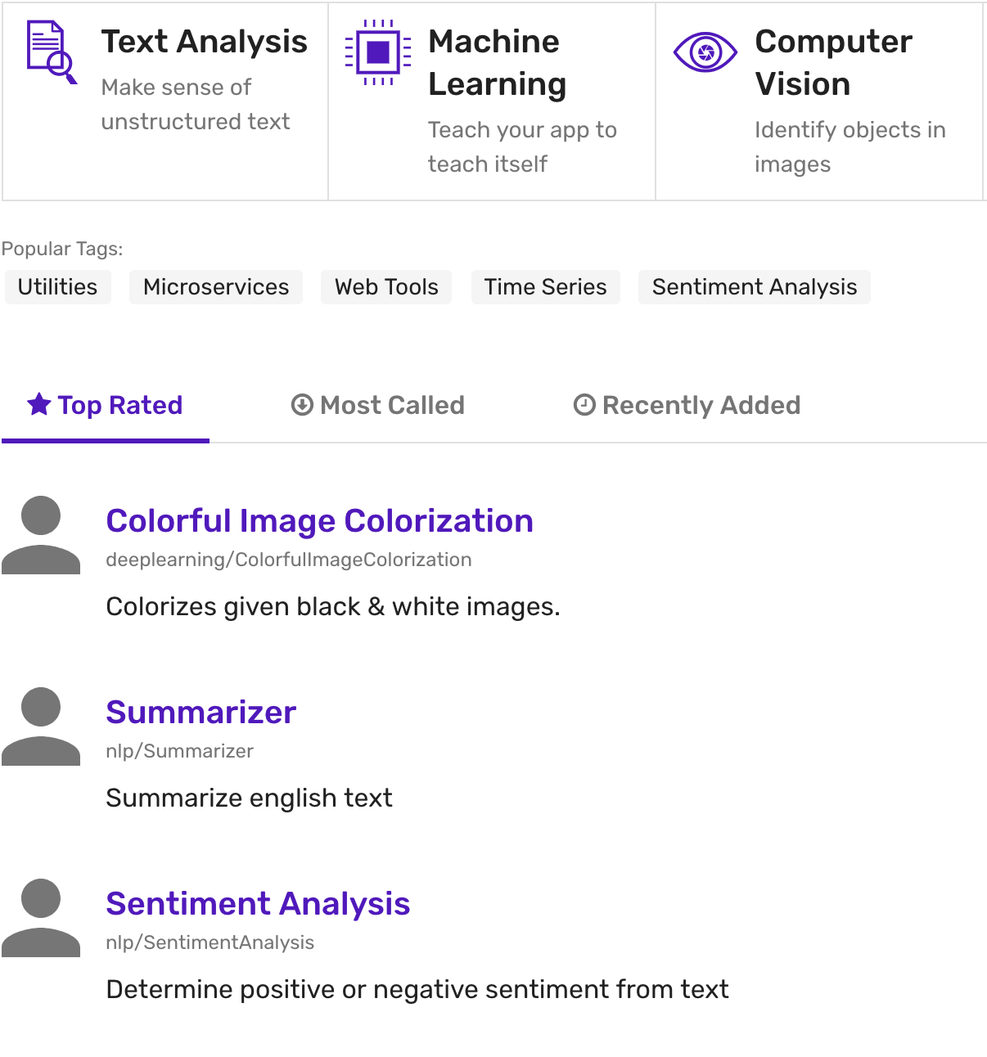
Discoverability: an App Store for AI
Notes:
Finally there should be a discovery layer. Which means allow users to discover components of AI that either they or there colleagues have created and easily integrate those into their workflows. Similar to how you would find a repository on github or an app in the appstore, you should be able to grab pre-trained components off the shelf.

Slide 32
Algorithmia’s OS for AI: discover a model
1. Discover a model
AppStore-like interface
Categorized, tagged, rated
Well-described (purpose, source, API)
Notes:
We have a long way to go, but just to demonstrate that progress is coming: here’s one version of an OS for AI, as currently implemented

Slide 33
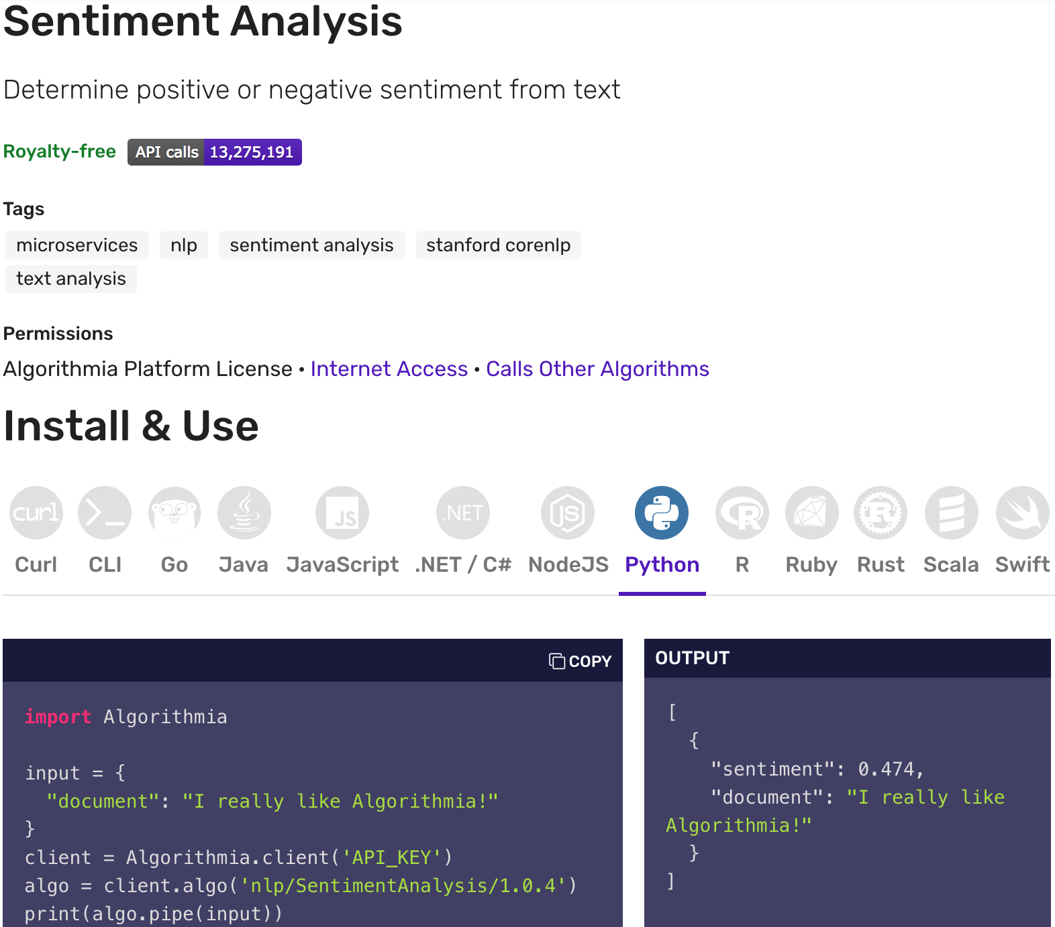
Algorithmia’s OS for AI: execute a model
2. Execute from any language
Raw JSON, or lang stubs
Common syntax
Autoscaled elastic cloud-exec
Secure, isolated
Concurrent, orchestrated
15ms overhead
Hardware agnostic
Notes:
We have a long way to go, but just to demonstrate that progress is coming: here’s one version of an OS for AI, as currently implemented

Slide 34
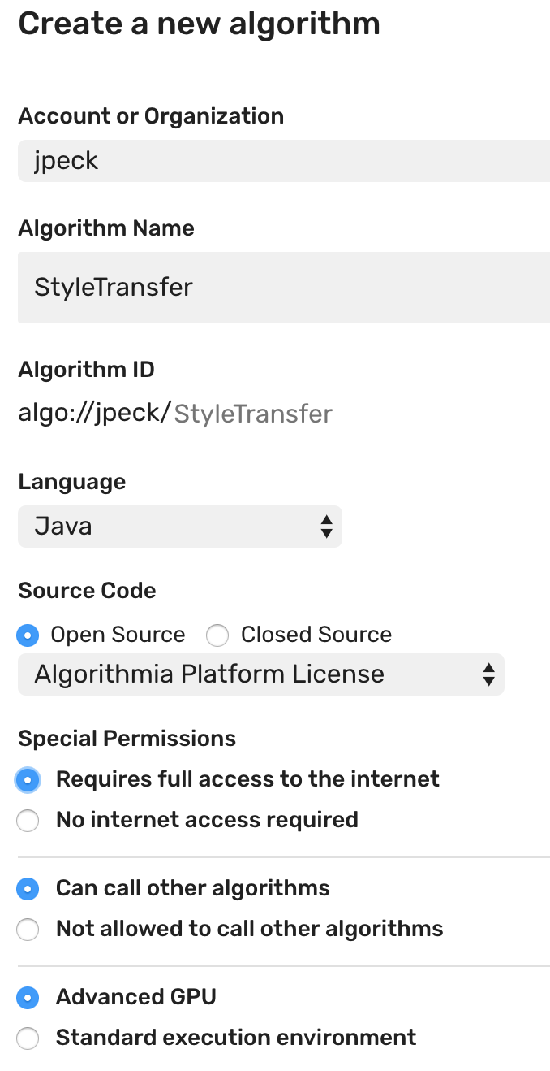
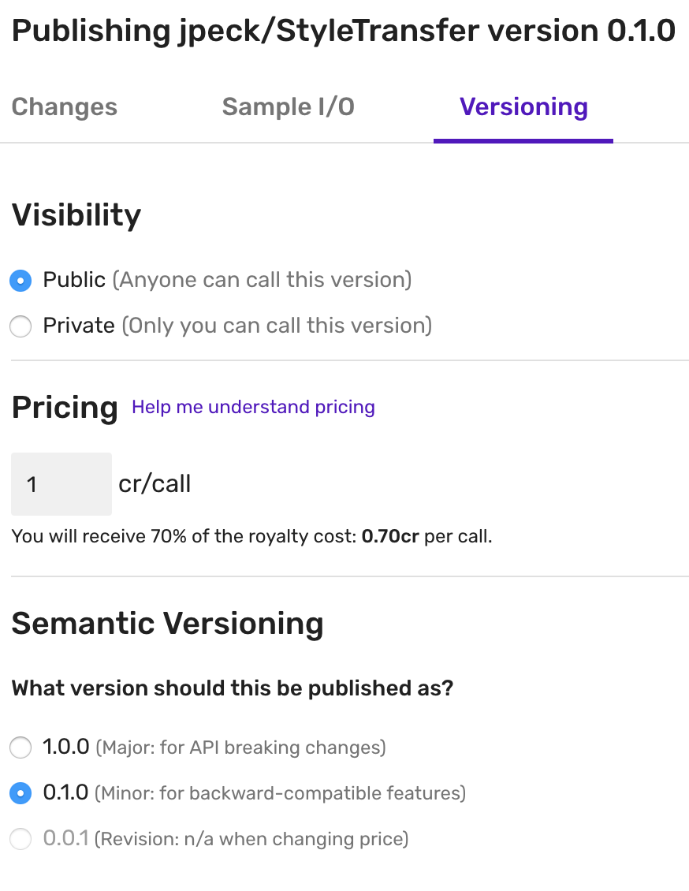
Algorithmia’s OS for AI: add a model
3. Add new models
Many languages, frameworks
Instant JSON API
Call other models seamlessly (regardless of lang)
Granular permissions
GPU environments
Namespaces & versioning
Notes:
We have a long way to go, but just to demonstrate that progress is coming: here’s one version of an OS for AI, as currently implemented

Slide 35
FREE STUFF
$50 free at Algorithmia.com signup code: WOSC18
Thank you!
Jon Peck Developer Advocate
jpeck@algorithmia.com
@peckjon
WE ARE HIRING
algorithmia.com/jobs
Seattle or Remote
Bright, collaborative env
Unlimited PTO
Dog-friendly
Algorithmia.com
Notes:
I hope today has given you a glimpse into what the OS for AI might look like. Have thoughts or questions? Please reach out!

