Slide 1
Why Serverless can work for enterprises?

Slide 2
I’m..
Satish Malireddi
Principal Architect @T-Mobile
Part of Cloud Center of Excellence
Serverless Advocate
Focus: Cloud Technologies, Application Design & Architecture, Developer Experience & Tooling

Slide 3
Agenda
T-Mobile’s Serverless Journey
Challenges
Business Case
Toolset & Serverless Adoption
Use Cases
Adoption Plan (that worked for us!)

Slide 4
Serverless Journey…
Thousands of Functions
Millions of Invocations per day
Jazz - Production Ready!
3X growth in serverless workloads
Tier-1 Applications
Spike in $, #requests & #resources
2017
2019
2018
2020
Proof of concepts
Microsites
Policy & Compliance Manager
Jazz – Open source
Platform Strategy - Serverless First
Billions of events per month
Multiple apps in production
Jazz Adoption

Slide 5
Challenges
Our serverless adoption journey was not easy.
Because many developers think serverless…
is new & immature
has limitations
requires a lot of architectural changes
ecosystem is always changing
might actually become expensive

Slide 6
Business Case
Why should we really use serverless?

Slide 7
Business Case
Cost
Security
Agility

Slide 8
Business Case
Security,
Governance & Compliance
Reduce dependencies
that hamper agility
Cost Control
Reduce costs for suitable workloads
Visibility into incurred costs
Secure from day 1
Complete visibility into what’s being built
Implement guardrails through the platform
100% Automation
Ease of Use
Improved Developer Experience
Training

Slide 9
Business Case
What Developers want?
Agility
Faster Time to Market
Ease of Use
What Management wants?
Governance
Visibility
Compliance
Standardization
Guardrails
Process Control

Slide 10
Toolset
We built Jazz,
a Serverless Development Platform
that enables developers to build
secure, compliant serverless apps
that are operationally ready from day one!
Jazz
https://github.com/tmobile/jazz

Slide 11
Breaking it down
Accelerate Serverless Adoption
Built around two themes –
Ease of use
Build compliant applications in the cloud
Enterprise processes are 100% automated
Self-Service enabled to reduce dependencies
Bridge gaps between actual serverless promise and the reality
Keep developers & management happy

Slide 12
Features
CI/CD
Standards & Security Controls baked in
Multi Tenancy
1-Click Environments
Best practices through code templates (application marketplace)
Governance & Compliance
Log collection, aggregation & analytics
Monitoring – Metrics, Dashboards & Alerts
Enterprise Integrations through extensions
Abstract Complexity with Cloud Provider solutions

Slide 13
How did Jazz help with adoption
Improved time to market
Faster access to the cloud
Lower environment creation is as easy a simple ”git commit”
Best practices are being shared
Developers are talking to each other

Slide 14
Top 5 Usecases
Single purpose APIs
Static Websites
Event driven applications/functions
Scheduled functions
Data transfer/manipulation/processing jobs

Slide 15
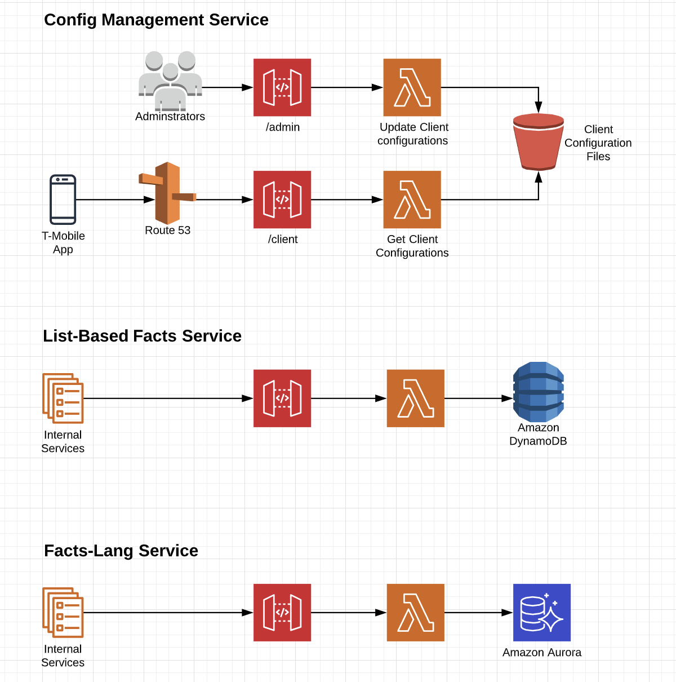
Usecases

Slide 16
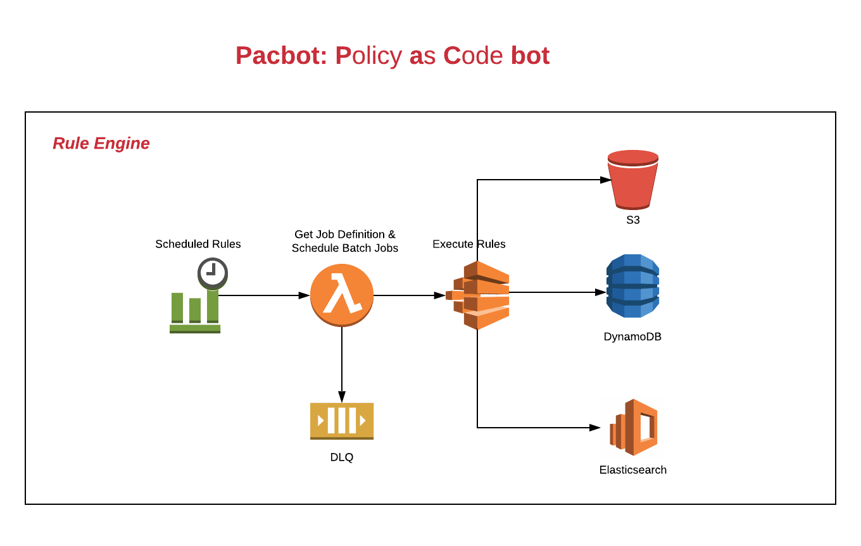
Usecases

Slide 17
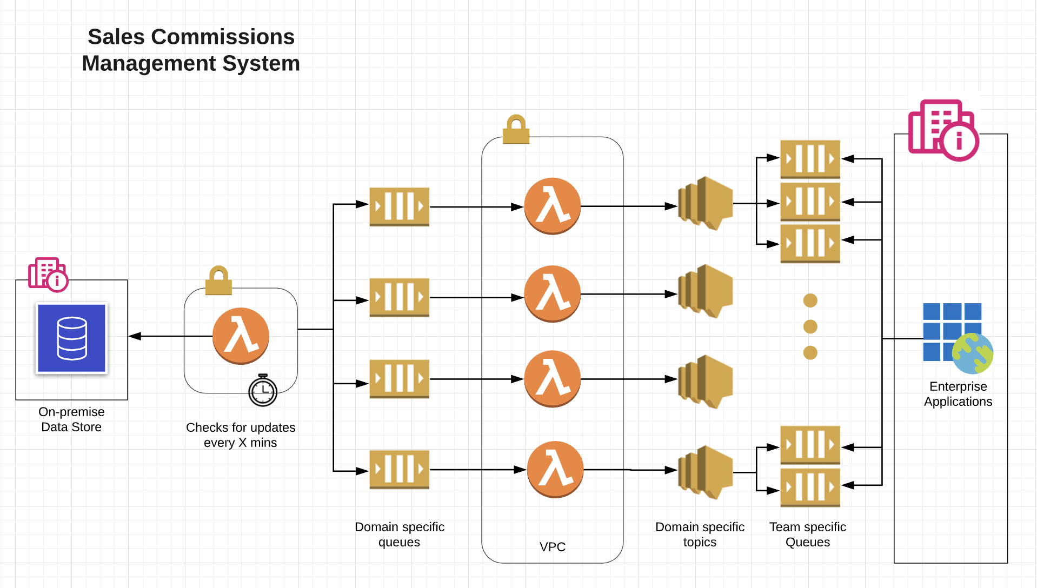
Usecases

Slide 18
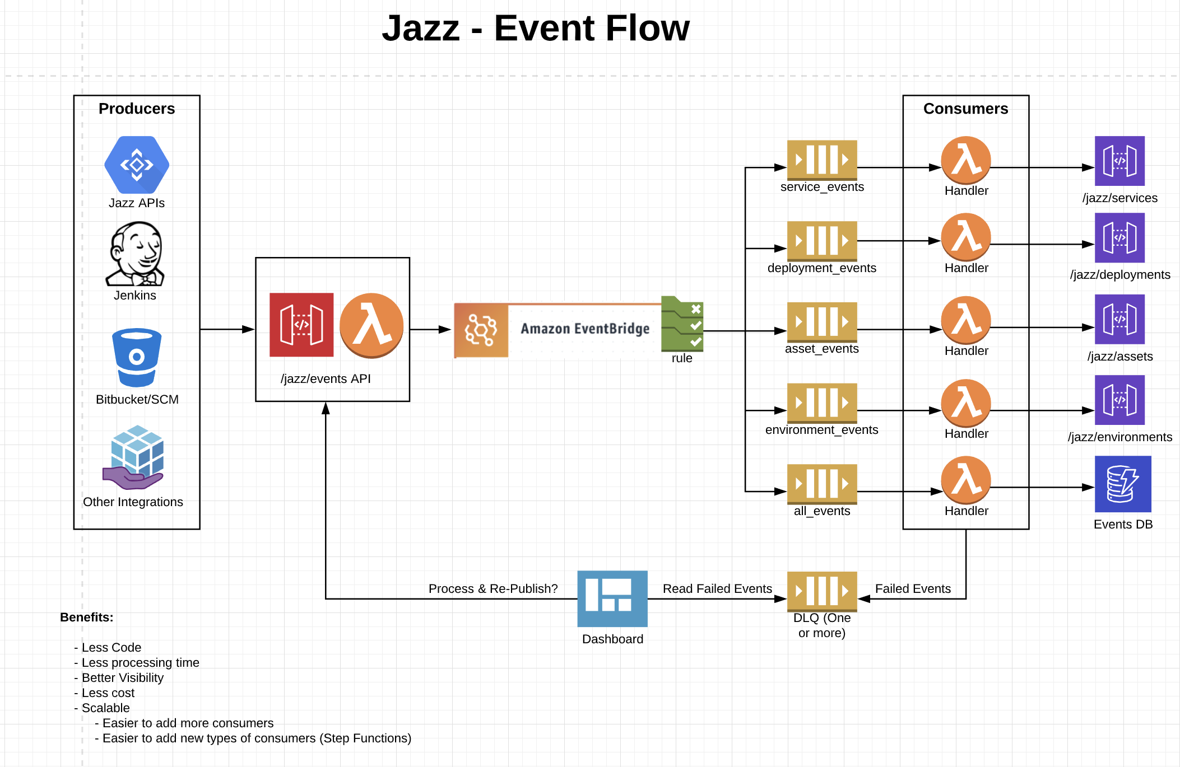
Usecases

Slide 19
Challenges still remain..
Difficult to change developer mindset
Looking for Lift-n-Shift
Constrained by lot of factors when making modern design choices
Developers are not aware of Op-Ex savings
Lack of training, not being up-to-date with technology
Technical limitations with cloud offerings (might go away with time)

Slide 20
Plan that worked for us
Identify use cases that are best suited and go after them
Don't over engineer! Serverless might not be the perfect fit for all your applications
Provide visibility into cost savings/estimates during the development phase
Training (most of the time its about people not being aware) & make it a continuous exercise
Have CoE teams: Dedicated folks who can experiment, learn, train others, identify tools to empower developers
Create framework for developers so that they can experiment easily within controlled guard rails
If you are developing abstractions, listen to your developers to solve their pain points and improve developer experience

